Slide 1

RIDE IT Driver Engagement
Key Factors & Strategies for Improvement

Slide 2
About Us
RIDE IT is the multi-service mobility company. Along with ride-hailing services, RIDE IT also offers micro-mobility services such as e-scooters, e-bikes, e-Vespas as well as car sharing all under the same app.

Slide 3
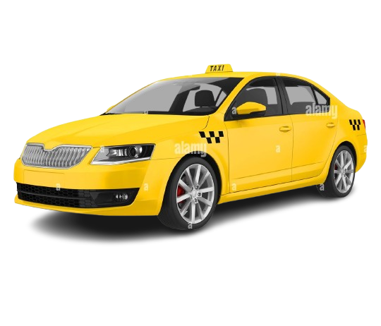
Overview
Objective: Identify key factors driving driver engagement and propose actionable recommendations.
Data Sources: Cancellation Analysis, Driver Retention, Performance, and Utilization Data.
Key Questions Addressed:
What factors influence better engagement?
Which driver segments perform well, and which need improvement?
What business initiatives or product changes can improve engagement?

Slide 4
Findings on Driver Engagement
High Performer Drivers (842 drivers):
10.1 rides/day (highest engagement).
4.91 rating (excellent customer feedback).
More gold achievements (indicating strong incentives).
Good Performers (3,719 drivers):
6.06 rides/day.
4.90 rating.
Low Performers (32,411 drivers):
1.8 to 3.8 rides/day.
Some drivers have a 100% cancellation rate.

Slide 5
Key Factors Affecting Engagement
Incentives & Rewards - High performers engage more due to bonus programs.
Driver Cancellations - Many drivers cancel every ride but maintain high ratings.
Retention Issues - Fluctuating retention rates, especially in April (40.06%).
Workload Distribution - Utilization rates vary significantly, some drivers overloaded.

Slide 6
Business Initiatives for Improvement
Targeted Incentives for Mid-Tier Drivers:
Bonus pay for completing X rides per week.
Flexible Matching System:
Allow drivers to pre-select ride types to reduce last-minute cancellations.
Re-Engagement Campaigns:
Reactivation bonuses and seasonal incentives.

Slide 7
Intelligent Ride Allocation:
Match drivers based on acceptance rates and past reliability.
Engagement Score Dashboard:
Create a system that provides personalized improvement suggestions.
Product Improvements for Better Engagement

Slide 8
Expected Outcomes
Increase in Retention Rate: More drivers staying active longer.
Reduction in Cancellations: Lower cancellation rate with better ride matching.
Higher Ride Acceptance Rate: Balanced workload among drivers.
Improved Driver Satisfaction: Higher earnings and better experience.
Visual: Line graph tracking engagement improvements over time.

Slide 9
Engagement is driven by incentives, workload balance, and retention efforts.
Implementing structured rewards and smarter ride allocation can enhance performance.
A data-driven approach will optimize driver satisfaction and business efficiency.
Conclusion

